Slide 1
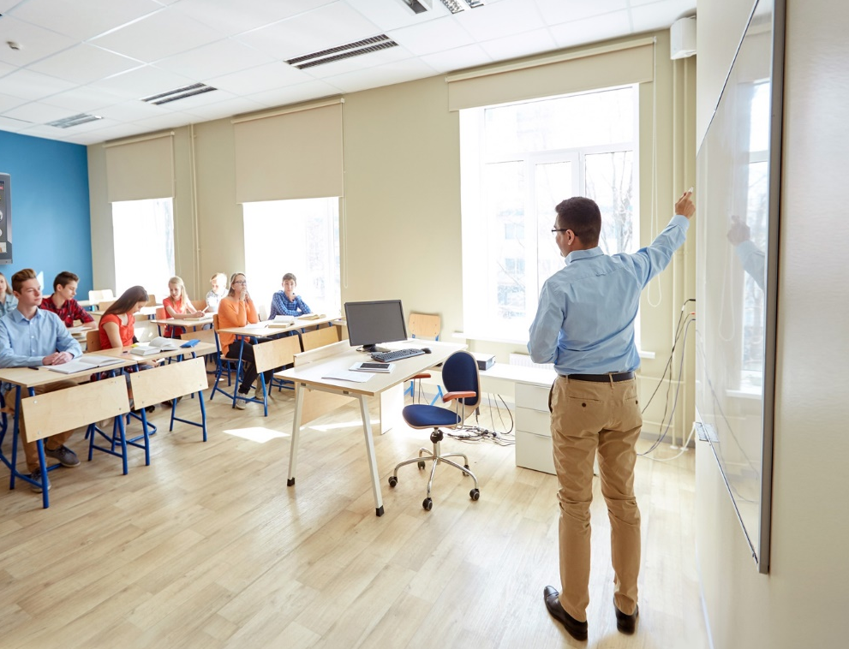

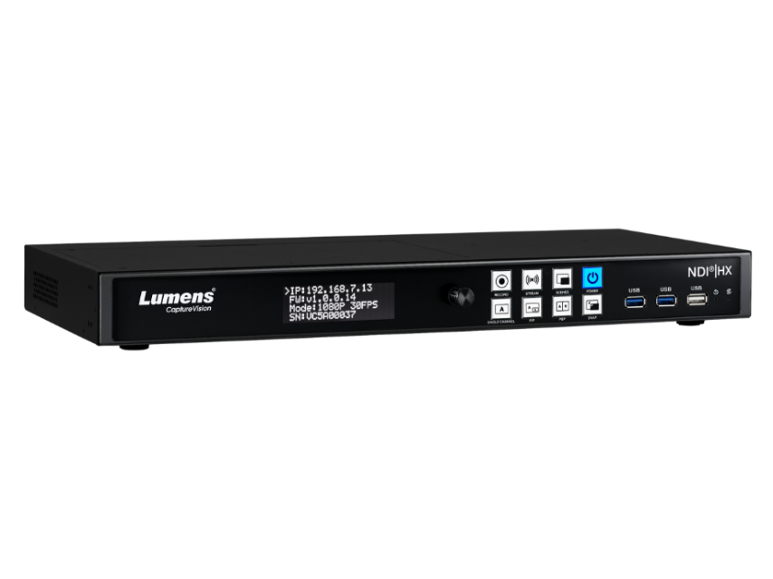
LC100N
2-Channel HD NDI|HX Recorder and Streaming
Media Processor

Slide 2

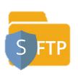








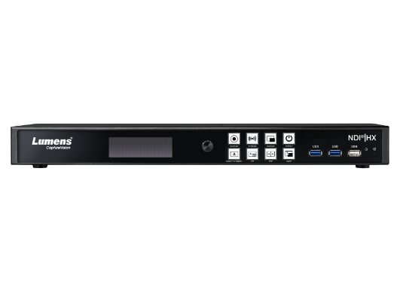
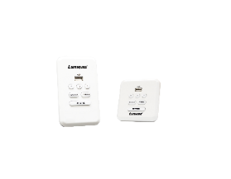



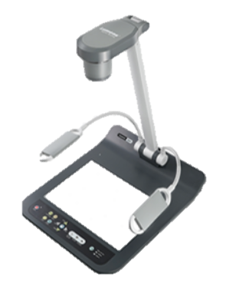

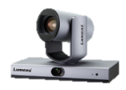

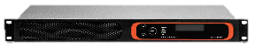
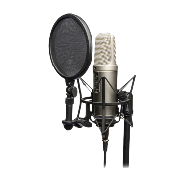
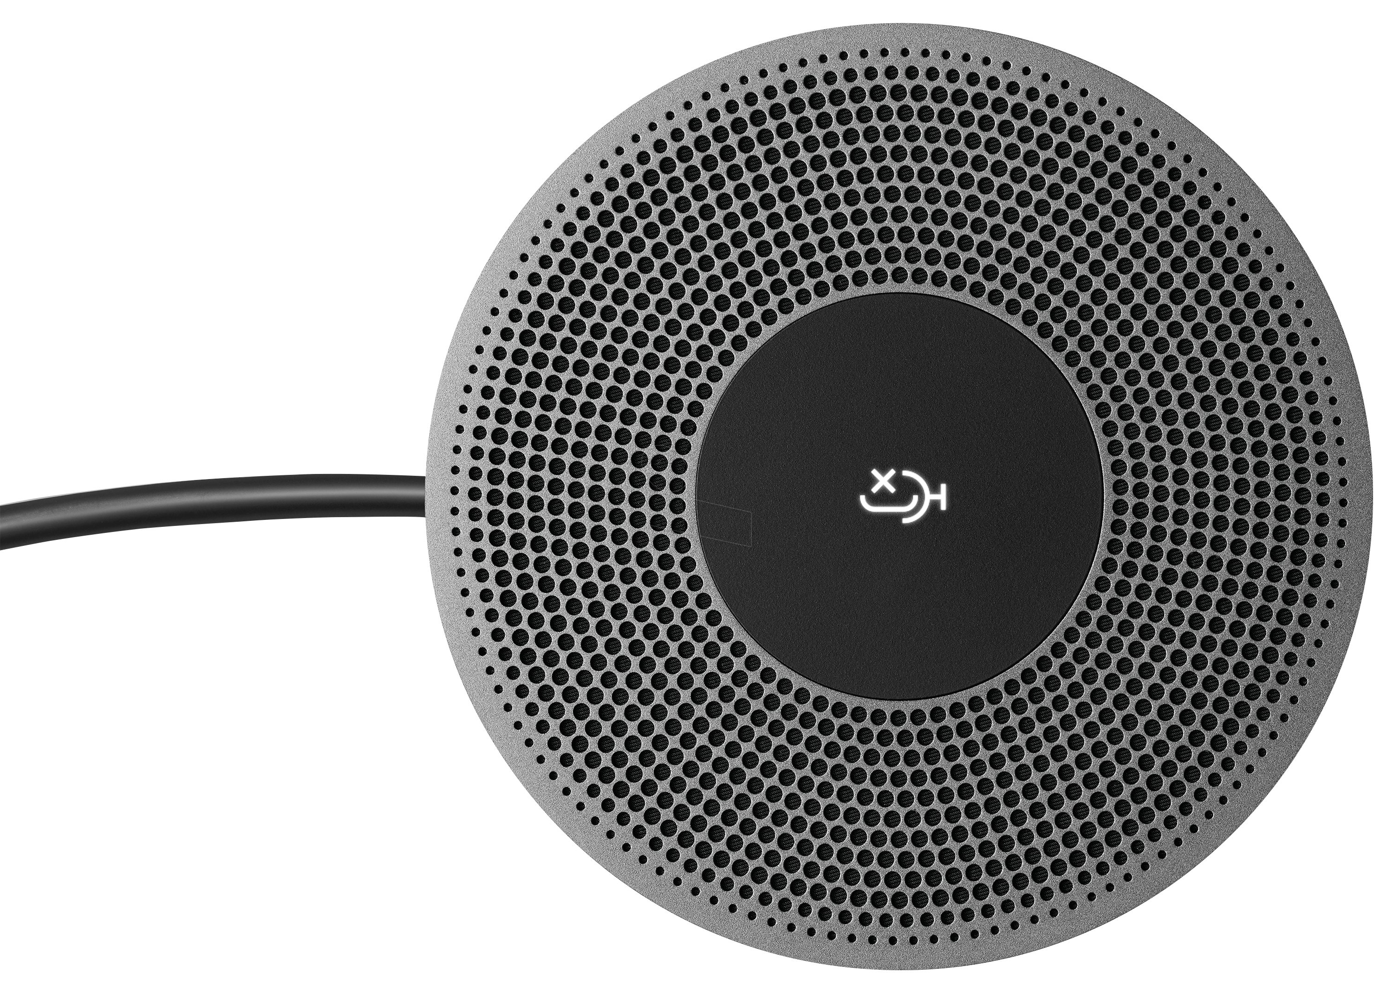

Recording & Live Streaming
NAS
FTP / SFTP
Video Files Backup
Live Streaming
Ethernet
Deployment Tool
Remote Control Panel
Media Processor LC100N
iCalendar
Control
Schedule
Desktop Document
Camera
Audio DSP
Portable Document
Camera
PTZ Camera
Tracking Camera
And NDI|HX camera
Content Laptop
(NDI|HX Screen Capture)
USB Microphone
XLR Microphone
Audio Source
Notes:
LC100N can integrate all video sources, audio sources, and do switch, mix, record, stream.
It will be perfect for applications that require recording and streaming.
It is ideal for lecture capture in education, streaming worship services, sharing corporate training, and live event delivery.

Slide 3
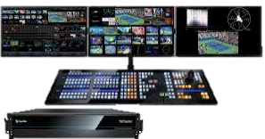
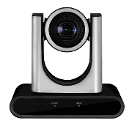
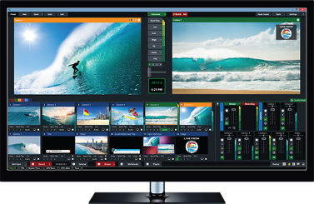
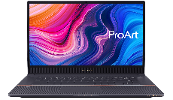

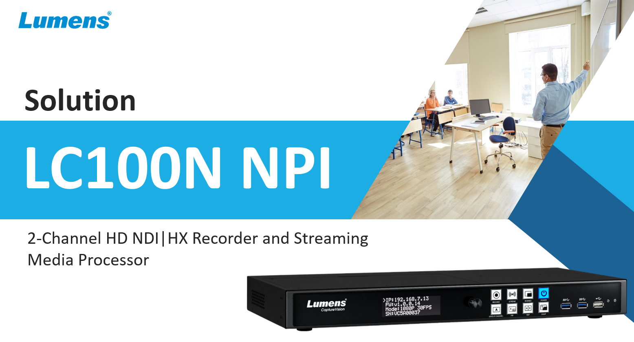

Broadcast solution
NDI|HX Camera
IP Camera (RTSP/HDMI/SDI/USB)
NewTek TriCaster
NDI|HX
Media Processor LC100N
NDI|HX
Screen Capture
vMix
Document Camera
(HDMI/USB)
Video Production
Video Sources
Video mixing and encoder to NDI|HX
Notes:
LC100N can be part of broadcast applications.
LC100N can receive the 1080p NDI|HX sources, like NDI|HX camera, or NDI®|HX screen capture software.
It can capture the video sources form HDMI, SDI, USB, IP, and do video mixing, and encode the mixing video to NDI|HX.
So, the production switcher or production software that supports NDI can receive the NDI|HX from the LC100N.

Slide 4



Conference solution
NDI|HX Camera
IP Camera (RTSP/HDMI/SDI/USB)
Media Processor LC100N
NDI|HX
NDI|HX
Screen Capture
NDI Webcam Input
(Virtual Camera)
Document Camera
(HDMI/USB)
Video processing such as PIP, and add overlay and background.
Conference Computer
Video Sources
Video mixing and encoder to NDI|HX
Notes:
Some video conferencing applications hope that the video screen is a programmed PIP screen (such as PPT content, plus the speaker's shooting screen)
LC100N can mix the 2 video source as PIP or PBP screen, with background, overlay.
Because it can output NDI|HX, LC100N can be the video source for NDI Webcam Input (NDI Virtual Camera).
This means that the PIP or PBP screen mixed by the LC100N can be added to the video conference application via NDI.

Slide 5
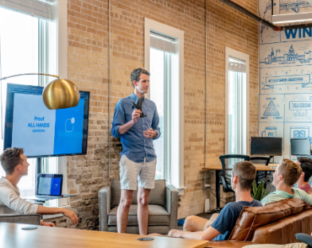
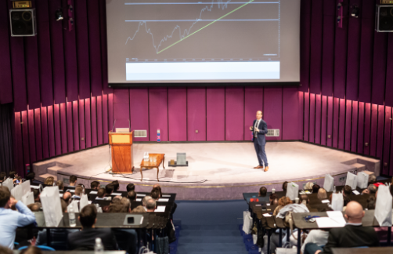
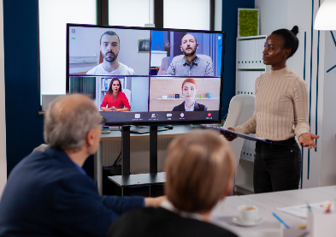


Application
Corporate Solution
#1 Recording
#2 Live Streaming
#3 Recording & Live Streaming
Corporate Training
Record corporate training sessions. You can upload it to the CMS system. Train your new employees effectively.
Live Corporate Events
Stream your corporate events and product promotion speech on streaming platforms to boost employee engagement and company awareness.
Hybrid Workplace
The hybrid workplace combines on-site office and remote working. You can maintain great communication in a flexible working environment.

Slide 6

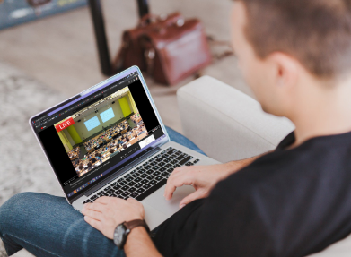

Application
Higher Education Solution
#1 Recording
#2 Live Streaming
#3 Recording & Live Streaming
Lecture Capture
Record lecture allows students to review the captured course 24/7 online.
Live Streaming Course
Stream your lectures, campus events, graduations or other ceremonies on various streaming platforms.
Hybrid Classroom
Hybrid teaching allows an instructor to lecture both remote students and students on campus synchronously.

Slide 7


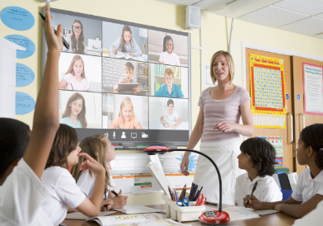
Application
K-12 Education Solution
#1 Recording
#2 Live Streaming
#3 Recording & Live Streaming
Lecture Capture
Record lecture allows students to review the captured course 24/7 online.
Live Streaming Course
Stream your lectures, campus events, graduations or other ceremonies on various streaming platforms.
Hybrid Classroom
Hybrid teaching allows an instructor to lecture both remote students and students on campus synchronously.

Slide 8
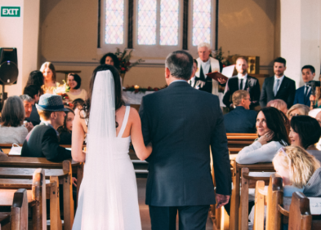
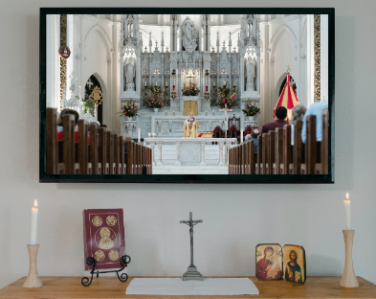
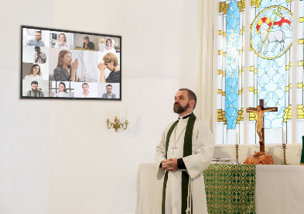
Application
House of Worship Solution
#1 Recording
#2 Live Streaming
#3 Recording & Live Streaming
Worship Events
Record masses, sermons, and other religious services and activities. Store the meaningful moment of each event forever.
Virtual Worship
Provide online sermons and classes. People who cannot attend services in person can still feel involved. Extend the reach among worshippers.
Hybrid Worship
Combine in-person and online ministry. It offers a new approach to the weekly house of worship services and other special occasions. Keep Your Congregation Engaged anywhere.

Slide 9
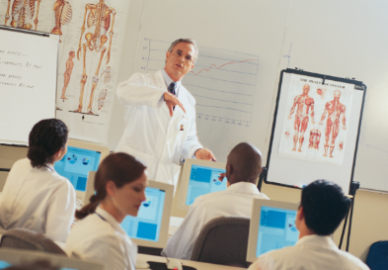
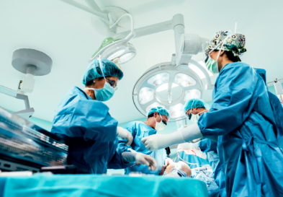
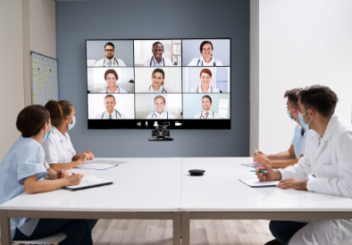
Application
Medical Solution
#1 Recording
#2 Live Streaming
#3 Recording & Live Streaming
Surgical Tutorial
Record Surgical process. Medical students can learn and practice from their own side.
Live Surgery
Live surgical solutions provide real-time monitoring of surgical progress for remote doctors or trainee teaching.
Hybrid Healthcare
Hybrid healthcare uses a combination of in-person and digital tools to bring all doctors together from any place. You can get in touch with worldwide experts easily.

Slide 10

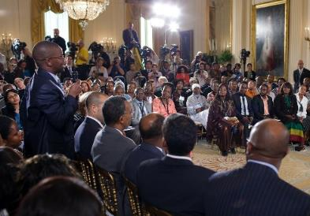

Application
Government Solution
#1 Recording
#2 Live Streaming
#3 Recording & Live Streaming
Council Meetings
Record complete of important meetings. It can convey the message to the missed viewers. Enhance and build public trust.
Live Press Conference
Live streaming conferences improve strong transparency. It makes it easier to increase civic engagement and reach the viewers.
Hybrid Summits
A hybrid summit provides a great way to enhance political communication between the government and the citizens. People now can feel more connected to joining process decision-making.

Slide 11
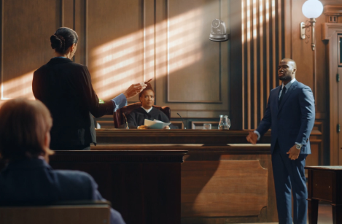
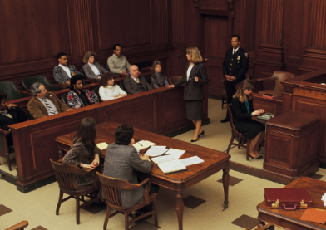
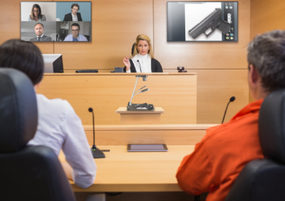
Application
Courtroom Solution
#1 Recording
#2 Live Streaming
#3 Recording & Live Streaming
Court Proceedings Recording proceedings is standard practice in most judicial systems. Digital archiving makes it quick, efficient and transparent to review, analyze and report cases.
Overflow Room
Streaming court proceedings delivers transparency to the judicial system and further elevates public confidence in the judicial system.
Hybrid Court Hearing
A hybrid court hearing elevates public confidence in the judicial system. The court attendance can involve in all parts of the proceedings event from a remote place.

